Slide 1
Critical Brain: the Statistical Physics of Neural Systems
Kevin Gilmore
Comprehensive Exam II Presentation
March 8th, 2016

Slide 2
Overview
Networks and the brain
Continuous phase transitions and critical phenomena
The Ising model
Criticality in neural systems
Experimental evidence
Neuronal avalanches
Information capacity and dynamic range
Conclusions

Slide 3
Thesis/Punchline
Think about motivation and intro sections in paper.
Circuit model (trad in neuro) inadequate. Alternatives?
Explanatory power. Minimal model with no biology. Neuronal avalanches and scale invariance.

Slide 4
What is a network?

Slide 5
What is the brain?

Slide 6
Continuous phase transitions

Slide 7
Critical phenomena

Slide 8
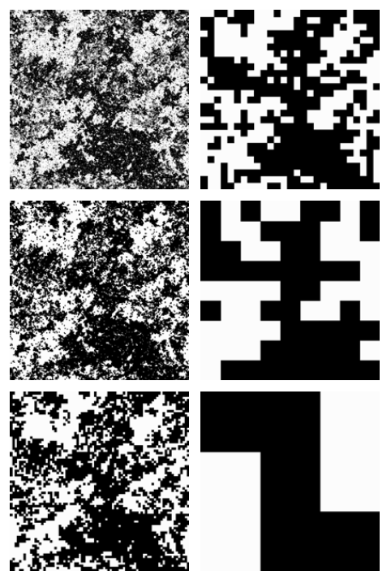
Scale invariance
Consequence of divergence of correlation length

Slide 9
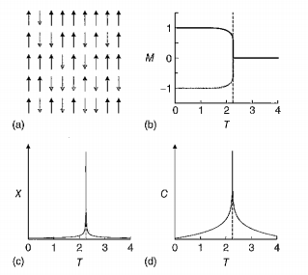
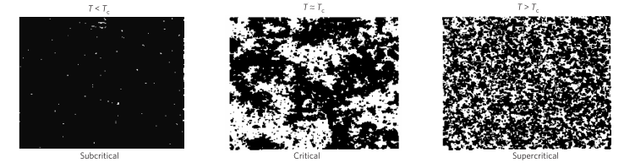

The Ising model

Slide 10
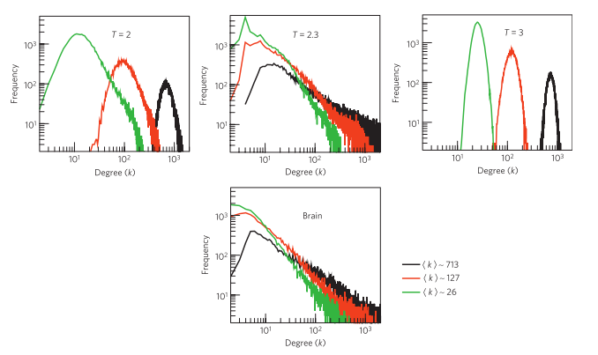
The Ising model: application to the brain

Slide 11


The Ising model & fMRI network details
x_{i}(t) is the brain oxygen level dependent (BOLD) signal of voxel i if we are studying
the brain data or the spin time series of site i from the Ising model. Averages taken over the length
of the time series (300 and 2000 points for the brain and the Ising model, respectively).

Slide 12
Criticality in neural systems

Slide 13
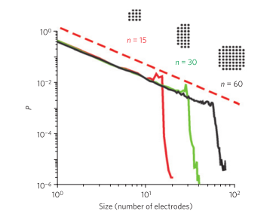
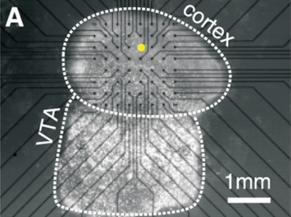
Neuronal avalanches: experimental evidence

Slide 14
Neuronal avalanches and scale invariance

Slide 15
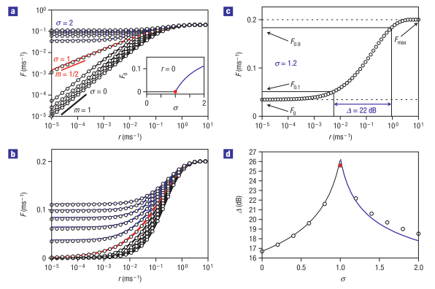
Information processing

Slide 16
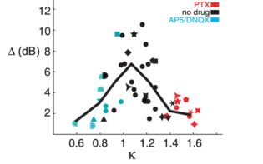
Dynamic range

Slide 17
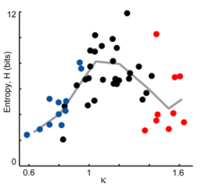

Information capacity
where n is the number of binary patterns and
p_{i} is the probability that a particular pattern i occurs

Slide 18
Impact

Slide 19
Conclusions

